Slide 1
Chapter 5
Understanding Requirements

Slide 2
Definition
Requirements are the capabilities and conditions to which the system -- and more broadly, the project -- must conform.
A systematic approach to finding, documenting, organizing, and tracking changing requirements

Slide 3
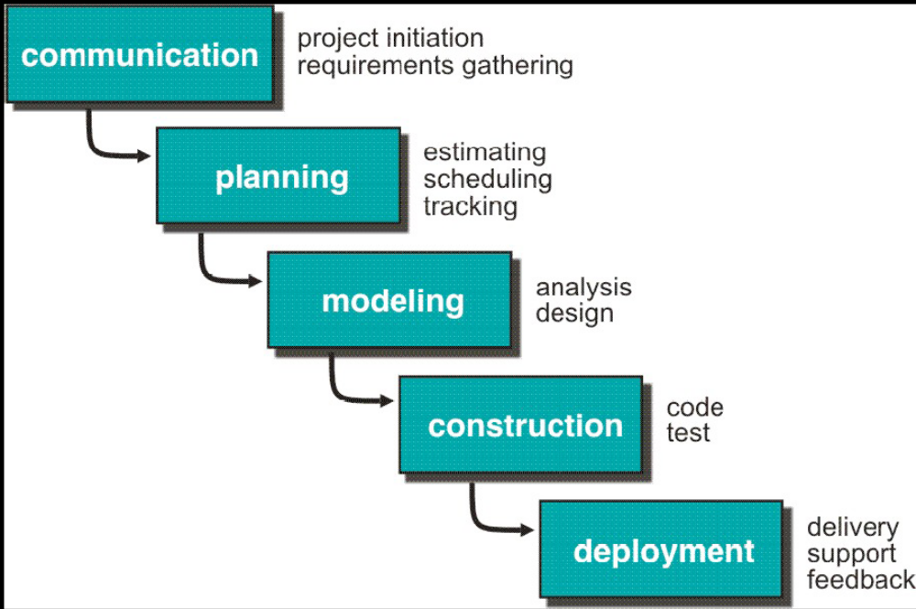
The Waterfall Model

Slide 4
The Waterfall Model Assumptions
1. All the required specification are well known in advance of implementation.
2. The requirements have no unresolved, high-risk implications.
• e.g., risks due to COTS choices, cost, schedule, performance, safety,
security, user interfaces, organizational impacts
3. The nature of the requirements will not change very much.
• during development, during evolution
4. The requirements are compatible with all the key system stakeholders’
expectations.
• e.g., users, customer, developers, maintainers, investors
5. The right architecture for implementing the requirements is well understood.
6. There is enough calendar time to proceed sequentially.

Slide 5
Demerits Waterfall model
Projects rarely follow sequential flow
Difficult to state all requirements upfront
Result obtained late in the project span
Performance degradation due to prolonged waiting

Slide 6
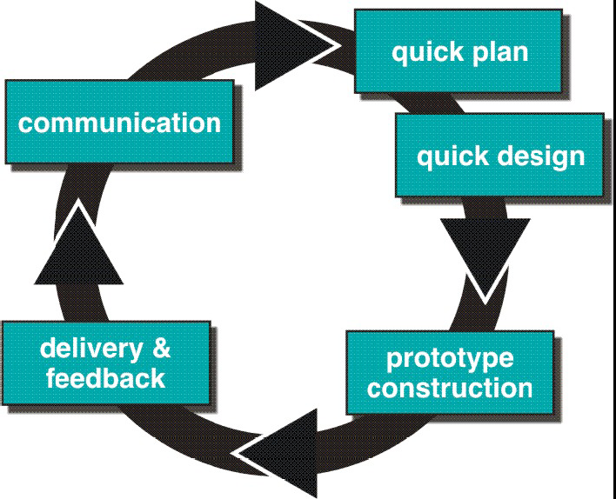
Evolutionary Models: Prototyping
Accommodate product that evolves over time

Slide 7
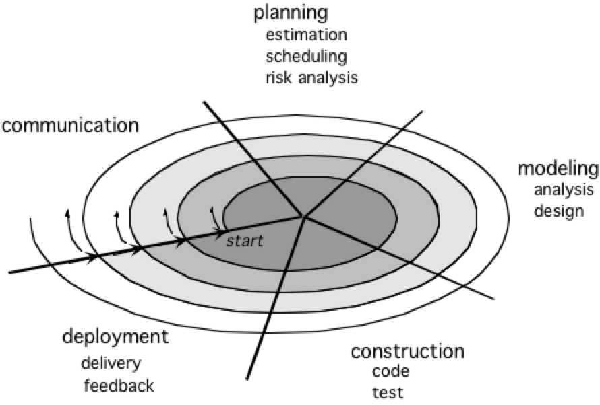
Evolutionary Models: The Spiral
Rapid development of complete versions of software

Slide 8
Finding Requirements
elicitation via techniques
  writing use cases with customers,
  requirements workshops that include both developers and customers,
  focus groups with proxy customers,
  a demo of the results of each iteration to the customers,
  to solicit feedback

Slide 9
Categories for Requirements FURPS+
Per Bob Grady at HP:
  Functional - features, capabilities,security
  Usability - human factors, help, documentation
  Reliability - frequency of failure, recoverability, predictability
  Performance - response time, throughput, accuracy, availability, resource usage.
  Supportability - adaptability, maintainability, internationalization, configuarability.

Slide 10
The “+” in FURPS+
The + refers to other important requirements:
  Implementation - resource limitations, languages and tools, hardware, …
  Interface - constraints imposed by interfacing with external systems
  Operations - system management in its operational setting.
  Packaging
  Legal - licensing and so forth.

Slide 11
Further terminology
The ‘ilities in FURPS are referred to as Quality Attributes or Quality Requirements.
Common usage: functional vs. non-functional requirements.

Slide 12
Capturing Requirements
Functional requirements are explored and recorded in the Use-Case Model and in the system features list of the Vision artifact.
Supplementary Specifications artifact contains requirements that don’t fit elsewhere.
The Glossary records and clarifies terms used in the requirements -- leads to Data Dictionary.

